Slide 1

Welcome to my YouTube channel Learn Loom

Slide 2
Dax Functions Note: Before learning DAX you must have foundational knowledge of Power BI basics, SQL basics, MS Excel, RDBMS

Slide 3
DAX
Data Analysis Expression is a formula language used in Excel, Power BI, and other business intelligence and data analysis applications from Microsoft. Data arranged in tables and columns is referred to as tabular data, and DAX is designed to work with tabular data.
DAX formulas are used in measures, calculated columns, calculated tables, and row-level security.
Furthermore, DAX is divided into Dax functions, Dax statements, Dax queries

Slide 4
Aggregation functions
Aggregation functions determine a single value, such as count, sum, average, minimum, or maximum, for all the rows in a column or table based on the specified expression.
Aggregation functions in Power BI are used to perform calculations on data, typically for summarizing or analyzing information in a more consolidated form. These functions are applied to columns or measures and help to generate meaningful insights.

Slide 5
Aggregation functions
Function: APPROXIMATEDISTINCTCOUNT
Syntax: APPROXIMATEDISTINCTCOUNT(<columnName>)
Description: The APPROXIMATEDISTINCTCOUNT function in Power BI is used to estimate the number of distinct values in a column while balancing performance and accuracy.
Column: Any type of data
Example:-
EstimatedDistinctProducts = APPROXIMATEDISTINCTCOUNT(‘financials'[Product])

Slide 6
Aggregation functions
Functions: AVERAGE, AVERAGEA, AVERAGEX
Syntax: AVERAGE(<column>), AVERAGEA(<column>), AVERAGEX(<TABLE_NAME>,<EXPRESSION>)
Description:
AVERAGE: Calculates the average of a column, including only numeric values.
AVERAGEA: Computes the average of a column, including non-numeric values(non-numeric=0)
AVERAGEX: Computes the average of the results obtained from the evaluation of an expression for each row in a table.

Slide 7
Aggregation functions
AVERAGE:
AVG_MARKS = AVERAGE(CLASS[MARKS])
AVERAGEA:
AVG_PASS = AVERAGEA(CLASS[PASS])
AVERAGEX:
AVG_PASS_EXP = AVERAGEX(CLASS, CLASS[MARKS]+20)

Slide 8
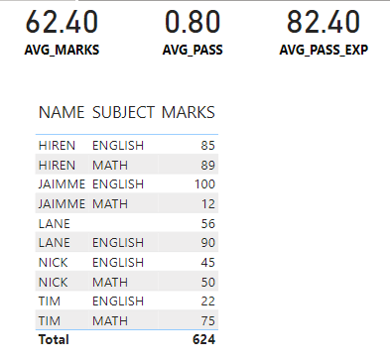
Aggregation functions

Slide 9

References
https://learn.microsoft.com/en-us/dax
Thank you

